Slide 1
DFSMS Basics:
Introduction to DFSMShsm

Slide 2
Agenda
Overview
DFSMShsm Functions
  Space Management
  Availability Management
  Miscellaneous Functions
DFSMShsm Architecture

Slide 3

Why Managed Storage?
Data has various Business Needs
  Business Critical
  Performance Intensive
  Production Data
  Test Data
  Historical Data
Hardware Devices and Storage Media Differences
  Faster
  Cheaper
  Portable
  Advanced Function

Slide 4



Life Cycle of a Data Set
Recall
Create
Migrate
When?
Directly to tape?
Read / Update
My Data
ABC
123
How frequently?
How many copies?
What technique?
Backup
Delete
Never?

Slide 5

DFSMShsm’s Role
DFSMShsm (hierarchical storage manager) is an automated policy-driven storage manager
Space Management
  Minimize the cost of storing data
  Ensure adequate free space to operate
Availability Management
  Recover data after loss

Slide 6
Space Management
Storage Hierarchy
High
Performance
Level 0 (Primary)
Disk
HSM Managed
$$$
L0
Data
Migration Level 1 (ML1)
Disk
HSM Owned
$$
ML1
$
ML2
Migration Level 2 (ML2)
Tape / Disk
HSM Owned
Low Cost

Slide 7
Space Management
Minimize Storage Cost
$$$
L0
Move Data Down in Hierarchy
Compact Data
Pack up to 24 data sets per track
Small Data Set Packing (SDSP)
Fill Tapes to their Capacity
Reduce Tape Mounts
$$
ML1
ML2
$

Slide 8

Space Management
Ensure Adequate Free Space
L0
High
Expire Data after certain time
Release Unused Allocated Space
Move Least-Referenced Data down in the hierarchy
Monitor Thresholds Hourly / Daily
Low
ML1
ML2

Slide 9
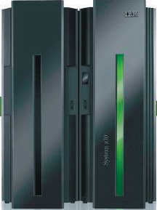
Space Management
Policies
Environmental
DFSMShsm SETSYS
DFSMShsm DEFINE
DFSMShsm
Host
SYS1.PARMLIB
SMS Storage Group
Automatic Migration?
Hourly Migration?
SMS
System Managed Storage
SMS Management Class
Expire days
Partial Release
Primary Days nonUsage
nonSMS Volumes
DFSMShsm ADDVOL / SETMIG
Automatic Migration?
Hourly Migration?

Slide 10
Space Management
Scheduled Functions
Automatic Primary Space Management
Normally is processed once a day
Process all eligible Primary (Level 0) volumes
Each primary volume is processed in two passes
  Pass 1
    Temporary data sets are deleted
    Expired data is deleted
    Overallocated space is released
    If Fast Subsequent Migration is turned on, FSM eligible data sets are reconnected (Explained Later)
    Determines which data sets on the volume are candidates for migration or extent reduction
  Pass 2 – If a volume is still over its low threshold of occupancy
    Processes candidates for extent reduction
    Migrates eligible data sets

Slide 11
Space Management
Scheduled Functions
Interval Migration
Runs hourly against specified Storage Groups / nonSMS volumes
  Processes volumes that are over threshold (mid or high)
Automatic Secondary Space Management
Normally is processed once a day and has several functions
  Delete expired migrated data sets
  Cleans up expired migration records from MCDS
  Performs migration from ML1 to ML2 for eligible data sets
Can be run during the day since it does not impact Primary (Level 0) volumes

Slide 12
Space Management
Recall Processing
Event or Command Driven
  When a migrated data set is referenced, DFSMShsm automatically moves the data back to primary storage
Basic Setup
  Recall requests are processed by the DFSMShsm host that initiated the recall
ML1 DASD
ML2
Tape
HSM 1
ML2
Tape
ML1 DASD
ML2
Tape
HSM 2
ML1 DASD
ML2
Tape

Slide 13
Space Management
Common Recall Queue
All requests are placed onto a shared queue from which all hosts can process requests
  Implemented using a Coupling Facility List Structure
HSM 1
ML2
Tape
ML1 DASD
ML2
Tape
ML1 DASD
ML2
Tape
HSM 2
ML1 DASD
ML2
Tape

Slide 14
Space Management
Data Flow
Migrate
ML1
ML2
Duplex
1 or 2 copies
L0
Recall

Slide 15
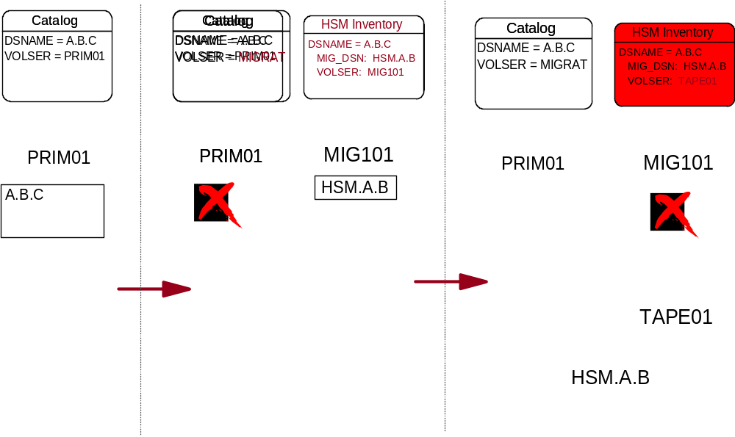
Space Management
Data Flow

Slide 16
Recycle
ML2
ML2
ML2
Duplex (Y/N)
1 or 2 copies
Backup
Backup
Backup
Input tapes are returned to scratch for reuse.

Slide 17
Space Management
Fast Subsequent Migration
Without FSM
With FSM
Level 0
DASD
1.Migrate
ML2
Tape
Level 0
DASD
1.Migrate
ML2
Tape
ML2
Tape
2. Recall
for Read
(no change)
2. Recall
for Read
4. Recycle
4. Recycle
reduced
3. Reconnect
to original tape
ML2
Tape
3. Migrate to
new tape
  SETSYS TAPEMIGRATION(RECONNECT(NONE | ALL | ML2DIRECT))

Slide 18
Availability Management
Protect against physical data loss and data corruption
DFSMShsm Inventory (Control Data Sets)
Individual data sets
DASD volumes
  DFSMShsm plays a lesser role in physical data loss due to RAID and Mirroring solutions
Aggregate groups of data
Fast Replication backup of Copy Pools
  Continuous Data Protection (CDP)
Recovery Point Objective (RPO): How close to a specific point in time do you need to recover to?
Recovery Time Objective (RTO): How quickly do you need to be able to recover?
Backup Window Objective (BWO): How long can your application be quiesced in order to create a data consistent backup?

Slide 19
Availability Management
Policies
Environmental
DFSMShsm SETSYS
DFSMShsm DEFINE
DFSMShsm
Host
SYS1.PARMLIB
SMS Storage Group
Automatic Backup?
Automatic Dump?
SMS
SMS Management Class
Backup Frequency
# Versions to maintain
How long to maintain versions
nonSMS Volumes
DFSMShsm ADDVOL
Automatic Backup?

Slide 20
Availability Management
Scheduled Functions
Automatic Incremental Backup
Backup Inventory and Journal data
Move backup versions from ML1
Backup migrated data sets
Backup user volumes
Automatic Dump
Expire dump tapes
Dump user volumes
Delete excess VTOC copy data sets

Slide 21
Availability Management
Commands
Individual data sets
  BACKDS
  HBACKDS
  ARCHBACK
  Inline (JCL) backup (ARCINBAK)
Aggregate Backup (ABARS)
Fast Replication

Slide 22
Availability Management
Backup Data Flow
Backup
Daily
L0
ML1
Duplex
1 or 2 copies
Recycle
VTOC Copy
Spill
Recover
** Logical Process –
Data Set Level

Slide 23
Availability Management
Dump Data Flow
Dump
Dump
Class 1
Dump
Class 2
L0
ML1
VTOC Copy
1 to 5 copies
Recover
** Physical Process –
Track level

Slide 24
Availability Management
Scenario – Lost Volume
RECOVER TOVOLUME(volser) UNIT(unit) FROMDUMP(APPLYINCREMENTAL)
Dump
Class 1
(1) Restore entire volume contents from Dump tape
L0
Daily
(2) Recover individual data sets with more recent backups

Slide 25
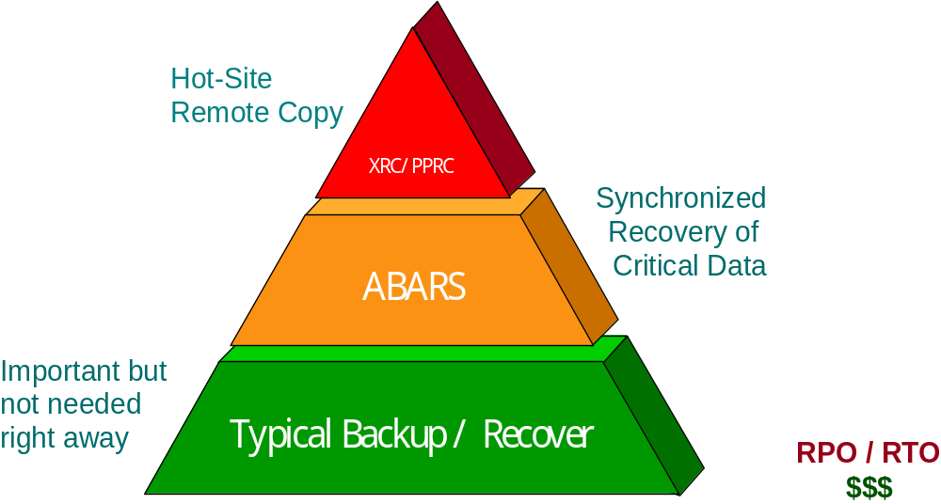
Availability Management
Where does ABARS fit in?

Slide 26
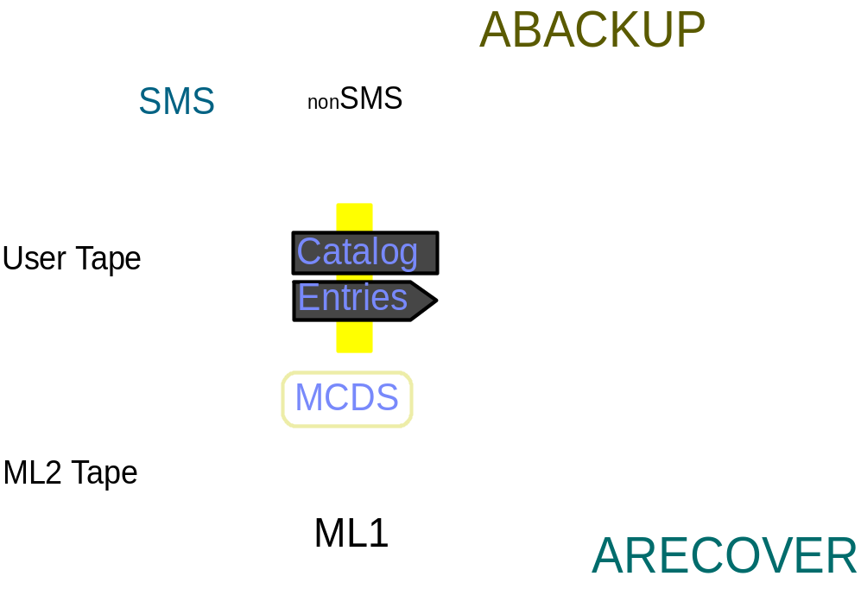
Availability Management
Aggregate Backup and Recovery Support (ABARS)
Creates a consistent backup of a related set of data
For example, a payroll application and its related data
Control File
Instruction
Activity
Other Data
1 to 15 Copies

Slide 27
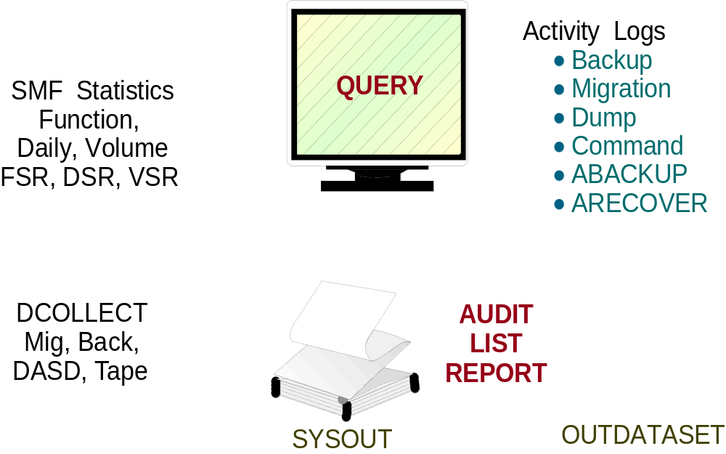
Miscellaneous
Reporting
New in V1R10 – Custom DFSMShsm reports via DFSMSrmm Report Generator!

Slide 28
DFSMShsm Architecture

Slide 29
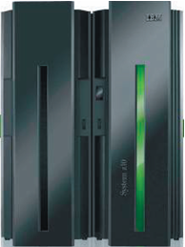
DFSMShsm Architecture
START DFHSM, CMD=00
SYS1.PROCLIB(DFHSM)
SYS1.LINKLIB(ARCCTL)
SYS1.PARMLIB
(ARCCMDxx,ARCSTRxx)
LOGX
LOGY
HSMplex
HSM 1
HSM 2
HSM n
PDOX
PDOY
Activity Logs:
Migration, Backup,
Dump,
Command, ABARS
MCDS
BCDS
OCDS
Journal
Control Data Sets

Slide 30
DFSMShsm Architecture
DFSMShsm is a “started task”
  This means that DFSMShsm is started on a z/OS system and remains operating in the system until it is stopped, canceled or abnormally ends.
DFSMShsm is executed as a “load module”
  ARCCTL – DFSMShsm load module name
  Typically resides in SYS1.LINKLIB or equivalent
  ARCCTL is link-edited with AC(1) so it can run authorized
The DFSMShsm proclib member contains:
  Name of DFSMShsm load library member
    EXEC PGM=ARCCTL
  DD statements for important data sets that DFSMShsm uses
  Various startup command options

Slide 31
DFSMShsm Architecture
DFSMShsm works with startup member(s) located in SYSn.PARMLIB
  Member name is ARCCMDxx, where “xx” is a number between 00 and 99
  e.g., ARCCMD01
ARCCMDxx member contains DFSMShsm commands that you want issued during DFSMShsm initialization processing every time you start DFSMShsm.
For example:
  SETSYS commands to set DFSMShsm system settings
  DEFINE commands to define various DFSMShsm settings

Slide 32
DFSMShsm Architecture
DFSMShsm’s inventory is maintained in four disk data sets
  Migration Control Data Set (MCDS)
    Inventory of Space Management function
      Data Sets and volumes that DFSMShsm is managing
  Backup Control Data Set (BCDS)
    Inventory of Availability Management function
      Data Sets and volumes that DFSMShsm is managing
  Offline Control Data Set (OCDS)
    Tape inventory
  Journal
    Contains an entry to track every DFSMShsm CDS Update
    Used to forward recover a CDS

Slide 33
DFSMShsm Architecture
More DFSMShsm CDS and Journal Information
CDSs are VSAM KSDS (key-sequenced) data sets
  RLS or non-RLS (Record Level Sharing)
  RLS allows VSAM data sets to be shared between DFSMShsm hosts at a record level rather than at a volume level
CDSs can be extended format or non-extended format
  Extended format enables individual cluster to be larger than 4-gigabytes
MCDS and BCDS can be up to four clusters
OCDS can only be one cluster
Journal can be normal sequential data set or a large format sequential data set
  Must be allocated as single-volume and single extent
  Special control record

Slide 34
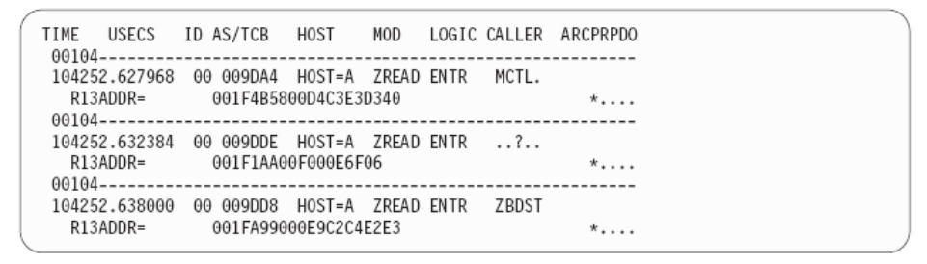
DFSMShsm Architecture
Other DFSMShsm data sets
PDOx/PDOy data sets
  Optional, but highly recommended
  Contain trace entries that trace DFSMShsm internal activity
  Tracing facility is called PDA – Problem Determination Aid
  Used for First Failure Data Capture
  ARCPRPDO– Footprint
LOGx/LOGy data sets
  Optional, unless you have certain ISV products
    Duplicate information to what is in SMF
  Contain meta-data logged by various DFSMShsm functions
  Often used by ISV products to track DFSMShsm activity

Slide 35
DFSMShsm Architecture
Other DFSMShsm data sets (continued)
Activity Logs
  Message logs for each of the main DFSMShsm functions
    Space Management
    Availability Management
    ABARS
    Dump Activity
    Command Processing
  Can specify what level of messaging is logged
    Full
    Reduced
    Exception only

Slide 36
DFSMShsm Architecture
START DFHSM, CMD=00
SYS1.PROCLIB(DFHSM)
SYS1.LINKLIB(ARCCTL)
SYS1.PARMLIB
(ARCCMDxx,ARCSTRxx)
LOGX
LOGY
HSMplex
HSM 1
HSM 2
HSM n
PDOX
PDOY
Activity Logs:
Migration, Backup,
Dump,
Command, ABARS
MCDS
BCDS
OCDS
Journal
Control Data Sets

Slide 37
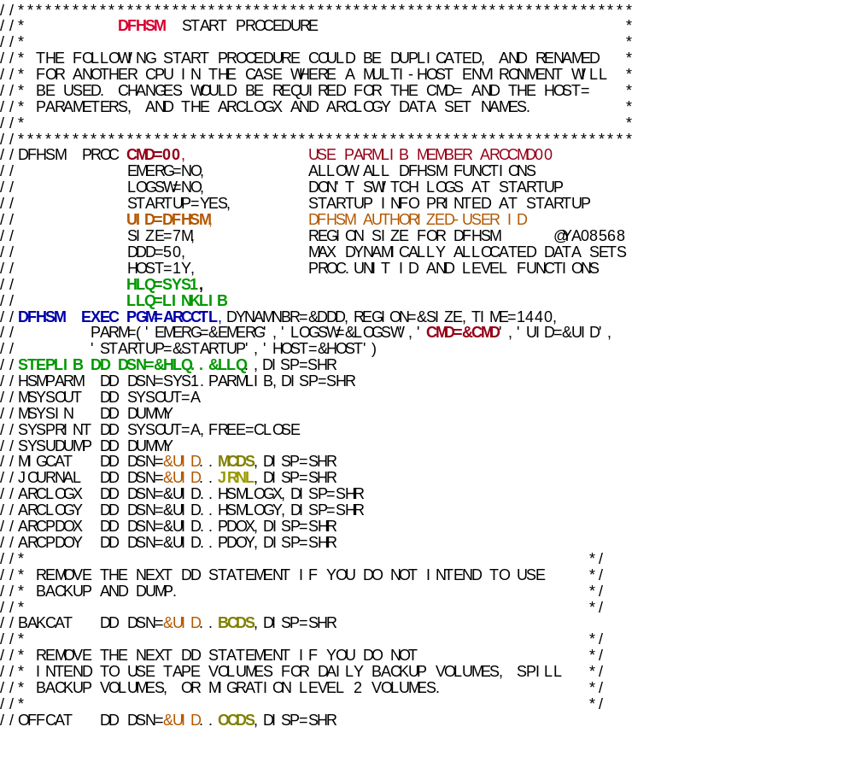

Slide 38
PARMLIB Member
SETSYS JES2 NOCONVERSION NOREQUEST NODEBUG NOEMERGENCY NOSWAP
SETSYS MOUNTWAITTIME(2) NOPROFILEBACKUP COMPACT(NONE) JOURNAL(SPEED)
SETSYS MONITOR(STARTUP VOLUME NOSPACE) NOSMALLDATASETPACKING
SETSYS TAPESECURITY(PASSWORD) INTERVALMIGRATION SMF(254)
SETSYS ABSTART(0000 0000) AMSTART(0000 0000)
SETSYS EXITOFF(AD BD CB CD MD MV RD TD TV)
SETSYS EXITOFF(MM IN SA)
SETSYS BACKUP VERSIONS(2) FREQUENCY(0) RECALL(PRIVATEVOLUME)
SETSYS SYS1DUMP
DEFINE BACKUP(Y)
SETSYS CDSVERSIONBACKUP(BACKUPD(DASD) BACKUPC(1))
QUERY SETSYS STARTUP CONTROLDATASETS BACKUP(ALL)
PATCH .ARCCVT.+3D3 X'C0'
PATCH .ARCCVT.+194 BITS(1.......)
AUTH HSMATH0 DBA(CONTROL)
AUTH HSMATH1 DBA(CONTROL)
AUTH HSMATH2 DBA(CONTROL)
AUTH HSMATH3 DBA(CONTROL)
AUTH HSMATH4 DBA(CONTROL
AUTH IBMUSER DBA(CONTROL)
SYS PDA(ON)

Slide 39
DFSMShsm Architecture
DFSMShsm basically allows three methods for initiating various processes
  Scheduled Functions
    Days grouped into cycles (which days to run the process)
    Times determined by START / STOP windows
    Process automatically starts / ends on appropriate days / time-of-day
  Event-Driven Functions
    Functions initiated when a certain event occurs such as a timer-pop
  Command-Initiated Functions
    Storage Administrators, Security Administrators or End-Users issue a command

Slide 40
DFSMShsm Architecture
DFSMShsm can receive commands from
  Operator’s console
    Via MVS Modify command
      F DFSMSHSM, HOLD AUTOMIGRATION
  TSO
    Issued from TSO terminal by an end-user or storage administrator
      HMIGRATE USER.DATASET
      HSEND MIGRATE DSN(USER.DATASET)
  ISPF Panels
    Various panels allow issuing various DFSMShsm commands
  Batch jobs
    EXEC PGM=IKJEFT01
    Commands listed in SYSTSIN stream

Slide 41
DFSMShsm Architecture
DFSMShsm can also receive commands from
  ARCCMDxx member during initialization
    Any DFSMShsm authorized command can be put into this PDS member
  Programmatically via various DFSMShsm assembler macros
    e.g. – ARCHSEND or ARCXTRCT
  DFSMShsm program that you can put in your JCL stream
    ARCINBAK – enables initiation of DFSMShsm backup command from a batch job

Slide 42
DFSMShsm Architecture
Two levels of DFSMShsm Commands
  Storage Administrator Commands
    These commands should be limited to a few Storage and Security Administrators
    Authorization to these commands can be controlled by RACF or equivalent
    Described in DFSMS Storage Administration Reference
    Can be issued from TSO via HSENDCMD
  End-User Commands
    Small set of DFSMShsm commands that can be issued by end-users
    Authorization to these commands can be controlled by RACF or equivalent
      Some commands have keyword level authorization
    Described in DFSMShsm Managing Your Own Data
    Can be issued from TSO via the various H… commands (e.g. HBACKDS)

Slide 43
Summary
DFSMShsm provides …
  Automated Space Management
  Automated Availability Management
  Command and Application interfaces
  Data Protection synergy with other IBM Products
  Disaster Recovery protection
  Reporting Capabilities

